Slide 1
AI for Everyone
Presidential Initiative for Artificial Intelligence and Computing

Slide 2
Objectives of this Course
The meaning behind common AI terminology, including neural networks, machine learning, deep learning, and data science
What AI realistically can--and cannot--do
How to spot opportunities to apply AI to problems in your own organization
What it feels like to build machine learning and data science projects
How to work with an AI team and build an AI strategy in your company
How to navigate ethical and societal discussions surrounding AI

Slide 3
$13 Trillion
AI value creation by 2030
Source: McKinsey Global Institute

Slide 4
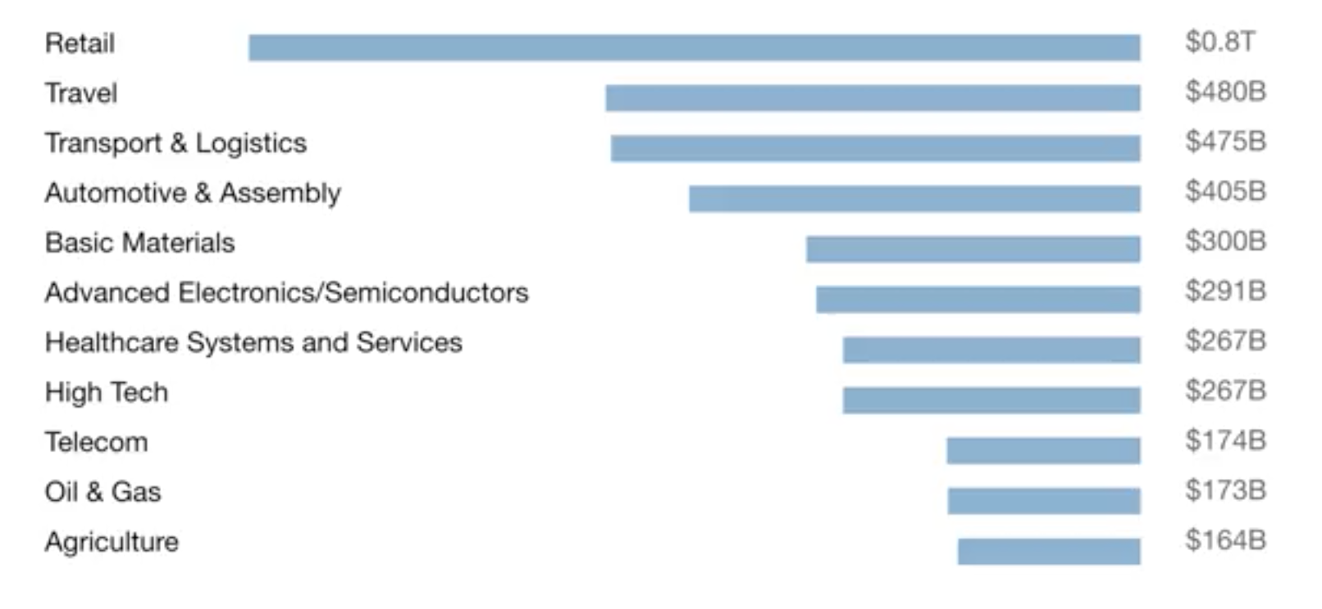
A lot of the value created by AI will be outside the software industry. AI will have a huge impact on all the major industries.

Slide 5
There are 2 types of AI
ALMOST NO PROGRESS
ANI
Artificial Narrow Intelligence
AGI
Artificial General Intelligence
LOTS OF PROGRESS
Notes:
There is a lot of excitement but also a lot of unnecessary hype about AI.
AI is actually two separate ideas.

Slide 6
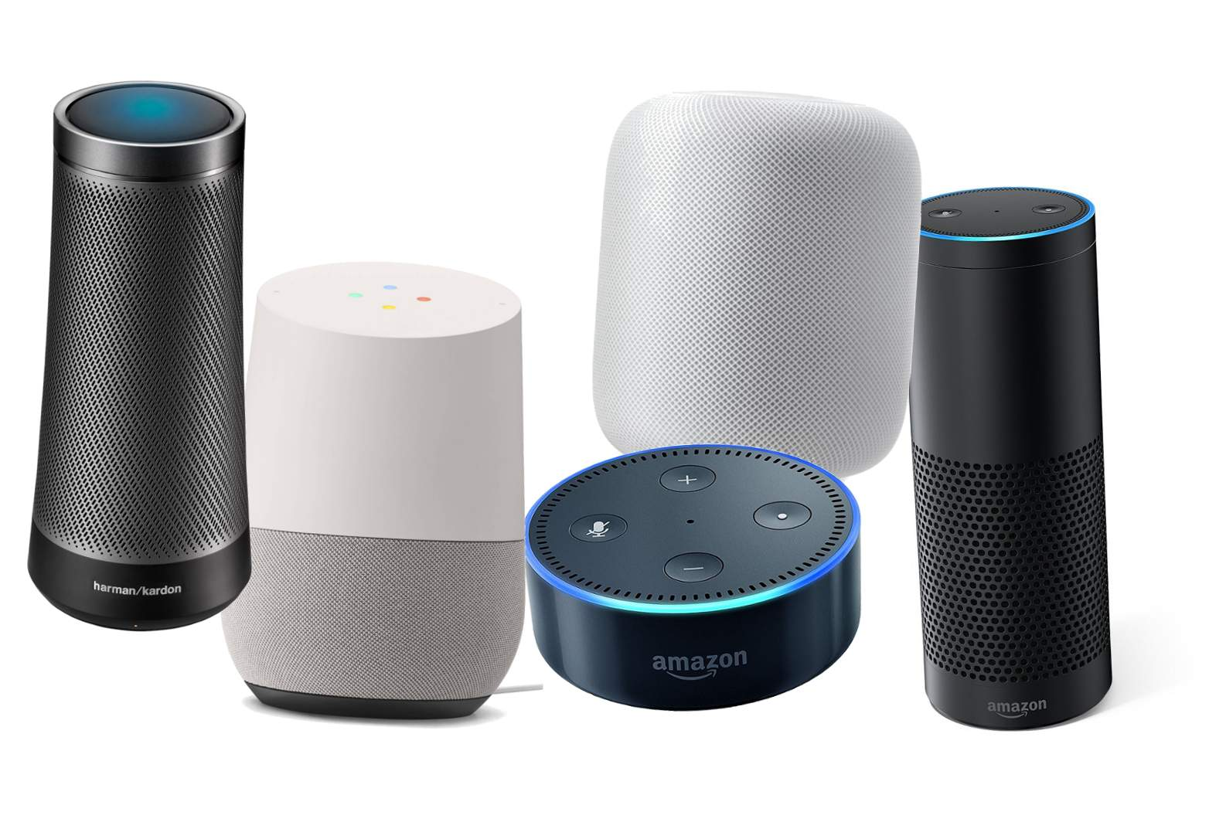
Artificial Narrow Intelligence (ANI)
These are AIs that do one thing such as:
smart speaker
self-driving car
AI to do web search
AI applications in farming or in a factory.
These types of AI are one trick ponies but when you find the appropriate trick, this can be incredibly valuable.

Slide 7

Artificial General Intelligence (AGI)
That is the goal to build AI.
They can do anything a human can do or maybe even be superintelligent and do even more things than any human can.

Slide 8

Progress in ANI vs AGI
The rapid progress in ANI has caused people to conclude that there's a lot of progress in AI, which is true. But that has caused people to falsely think that there might be a lot of progress in AGI as well which is leading to some irrational fears about evil clever robots coming over to take over humanity anytime now.

Slide 9
Achieving AGI Will Take Time
AGI is an exciting goal for researchers to work on, but it requires many technological breakthroughs before we get there and it may be decades or hundreds of years or even thousands of years away.

Slide 10
Machine Learning
The rise of AI has been largely driven by one tool in AI called machine learning.
You will start thinking how machine learning might be applied to your company or to your industry.

Slide 11



Supervised Learning
If the input is an audio clip, and the AI's job is to output the text transcript, then this is speech recognition.
Input (A)
Audio
Output (B)
Text (0/1)
Application
Speech Recognition

Slide 12



Supervised Learning
If you want to input English and have it output a different language, Chinese, Spanish, something else, then this is machine translation.
Input (A)
English
Output (B)
Chinese
Application
Machine Translation

Slide 13




Supervised Learning
All the large online ad platforms have a piece of AI that inputs some information about an ad, and some information about you, and tries to predict, will you click on this ad or not?
Input (A)
Ad + User Info
Output (B)
Click? (0/1)
Application
Machine Translation

Slide 14


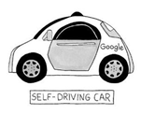

Supervised Learning
If you want to build a self-driving car, one of the key pieces of AI is the AI that takes as input an image, and some information from radar, or from other sensors, and outputs the position of other cars, so your self-driving car can avoid the other cars.
Input(A)
Image, radar info
Position of other cars
Self-Driving Car

Slide 15



Supervised Learning
In Manufacturing, we take as input a picture of something you've just manufactured, such as a picture of a cell phone coming off the assembly line., and you want to output, is there a scratch, or is there a dent, or some other defects on this thing you've just manufactured? This is visual inspection which is helping manufacturers to reduce or prevent defects in the things that they're making.
Input (A)
Image of a phone
Output (B)
Defects (0/1)
Visual Inspection

Slide 16
Supervised Learning
This set of AI called supervised learning, just learns input to output, or A to B mappings. On one hand, input to output, A to B it seems quite limiting. But when you find a right application scenario, this can be incredibly valuable.

Slide 17
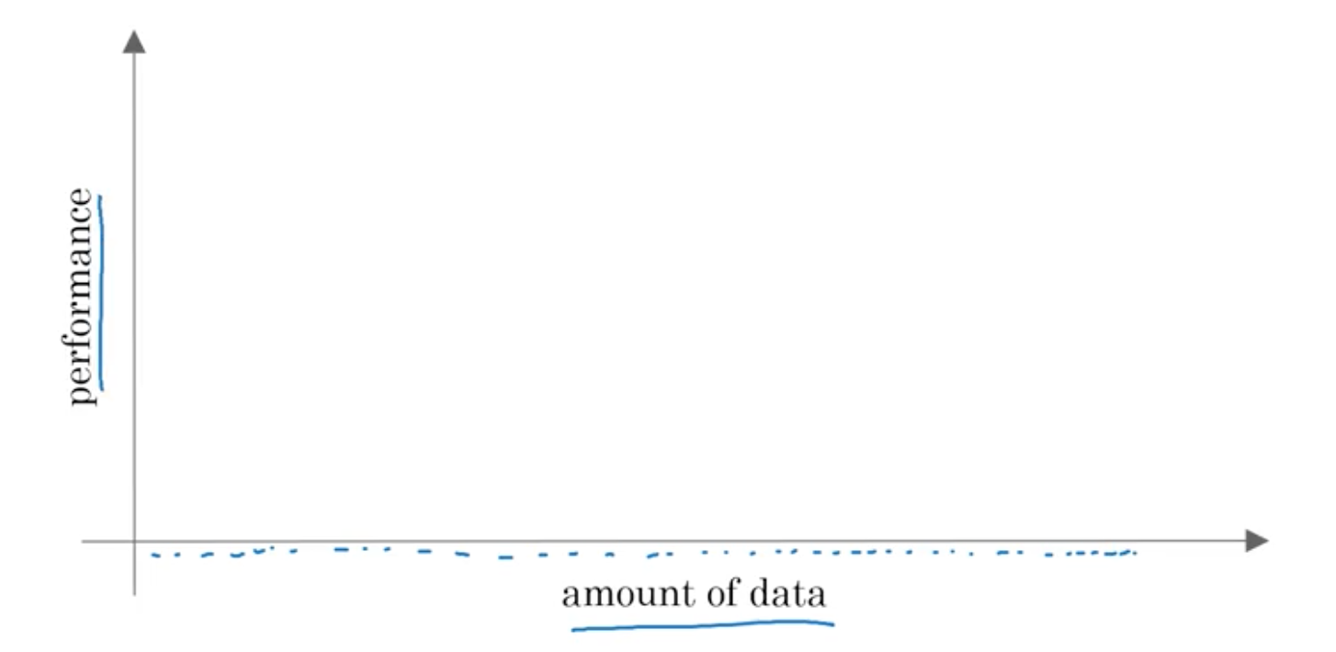
Why Now?

Slide 18
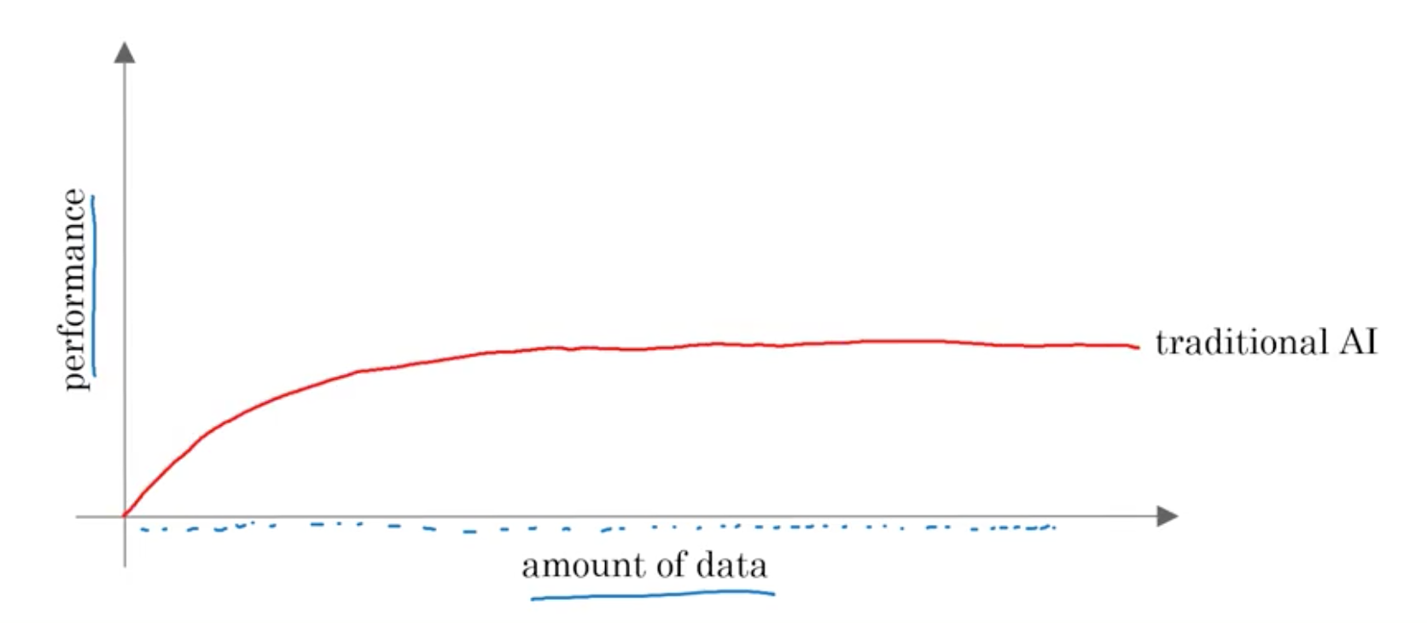
Why Now?

Slide 19
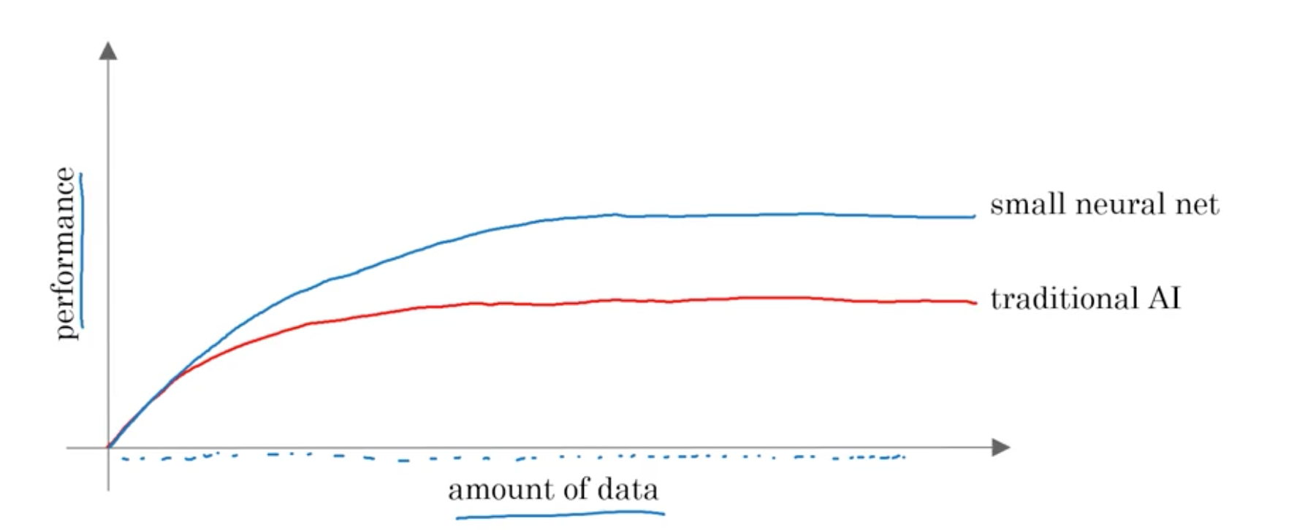
Why Now?

Slide 20
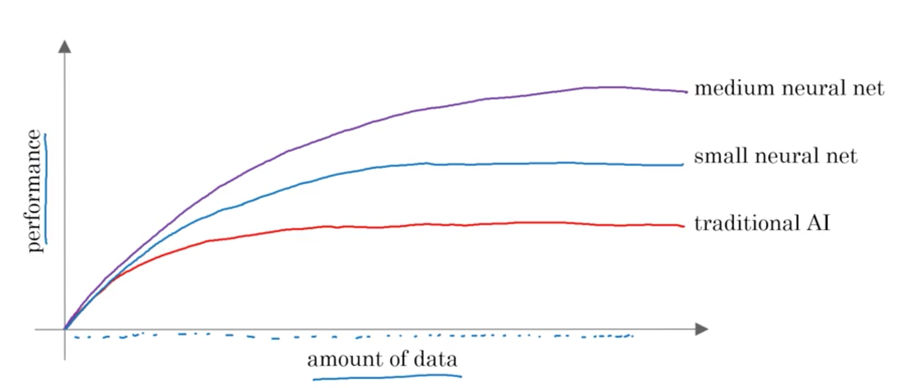
Why Now?

Slide 21
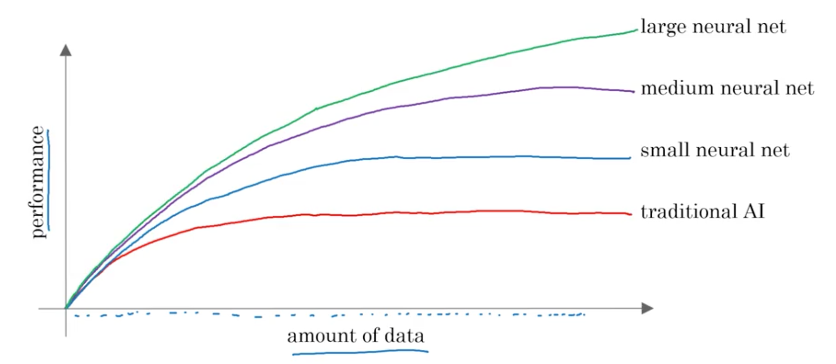
Why Now?

Slide 22
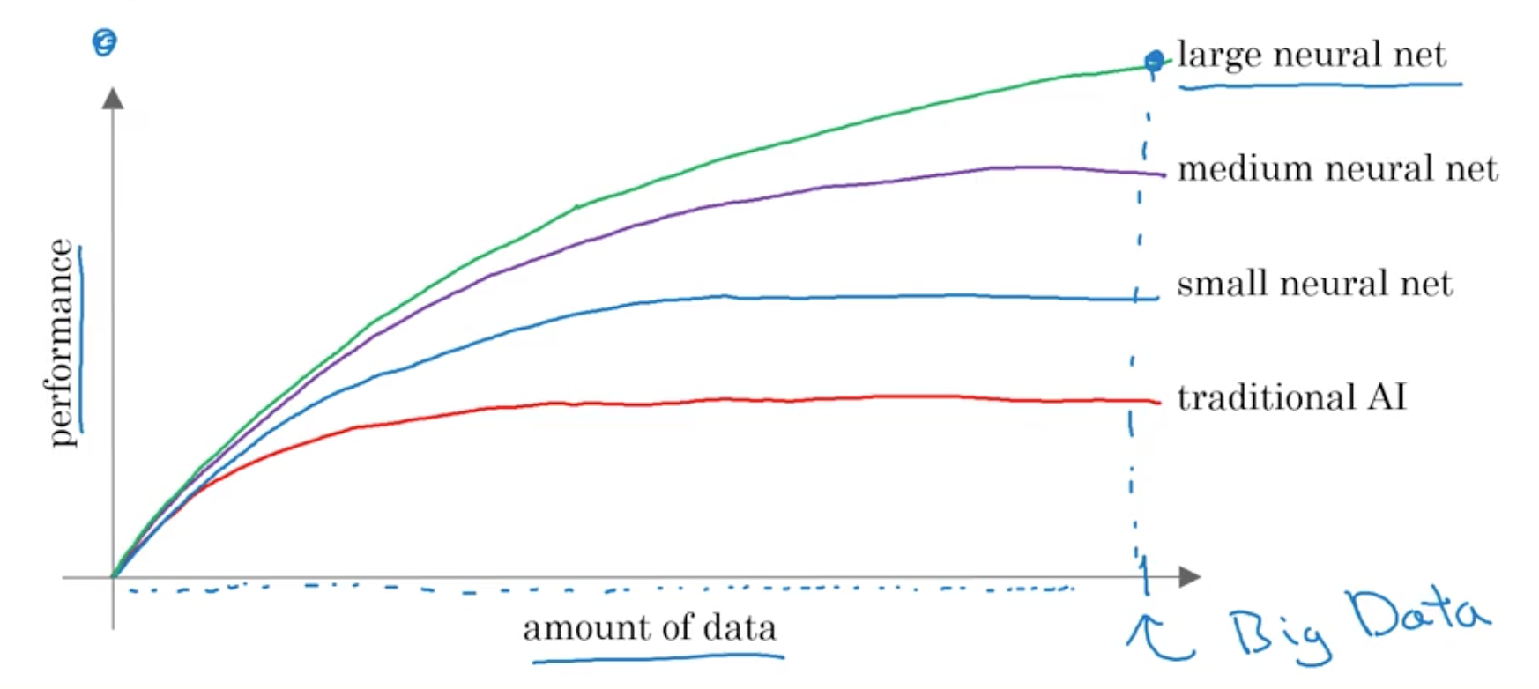
Why Now?

Slide 23
The Rise of Fast Computers
So, the rise of fast computers with specialized processors such as graphics processing units or GPUs has enabled many companies, not just giant tech companies, but many many other companies to be able to train large neural nets on a large enough amount of data in order to get very good performance and drive business value.

Slide 24
What is the most important
idea in AI?

Slide 25
Machine Learning

Slide 26
What is Supervised Learning?

Slide 27
A to B mappings
Input to Output mappings

Slide 28
What enables machine learning
to work so well?

Slide 29
What is Data

Slide 30
A Table of Data (Dataset)
Size of House (Square Feet) | Price ($1000)
523 | 115
645 | 150
708 | 210
1034 | 280
2290 | 355
2545 | 440
A | B

Slide 31
A Table of Data (Dataset)
Size of House (Square Feet) | # of Bedrooms | Price ($1000)
523 | 1 | 115
645 | 1 | 150
708 | 2 | 210
1034 | 3 | 280
2290 | 4 | 355
2545 | 4 | 440
A |  | B

Slide 32
Data is often unique to your business
Data is often unique to your business, and this is an example of a dataset that a real estate agency might have that they tried to help price houses.
It's up to you to decide what is A and what is B, and how to choose these definitions of A and B to make it valuable for your business.

Slide 33
Another example
If you have a certain budget and you want to decide what is the size of house you can afford, then you might decide that the input A is how much does someone spend and B is just the size of the house in square feet, and that would be a totally different choice of A and B that tells you, given a certain budget, what's the size of the house you should be maybe looking at.

Slide 34
A Table of Data (Dataset)
Size of House (Square Feet) | # of Bedrooms | Price ($1000)
523 | 1 | 115
645 | 1 | 150
708 | 2 | 210
1034 | 3 | 280
2290 | 4 | 355
2545 | 4 | 440
B |  | A

Slide 35

Acquiring data
Manual labeling

Slide 36
Acquiring data
From observing behaviors of humans
User ID | Time | Price ($) | Purchased
4783 | Jan 21 08:15.20 | 7.95 | yes
3893 | Mar 3 11:30.15 | 10.00 | yes
8384 | Jun 11 14:15.05 | 9.50 | no
0931 | Aug 2 20:30.55 | 12.90 | yes

Slide 37
Acquiring data
From observing behaviors of machines
Machine | Temperature | Pressure (psi) | Machine Fault
17987 | 60 | 7.65 | N
34672 | 100 | 25.50 | N
08542 | 140 | 75.50 | Y
98536 | 165 | 125 | Y
Input A |  |  | Input B

Slide 38
Acquiring data
Download from websites / partnerships
Thanks to the open internet you can find so many datasets available for free online
Computer vision or image datasets
Self driving car datasets
Speech recognition datasets
Medical imaging datasets
Keep in mind licensing and copyright

Slide 39


Use and misuse of data
Give me three years to build up my IT team, we're collecting so much data.
Then after three years, I'll have this perfect dataset.
We'll do AI then.
What’s wrong with this approach?

Slide 40
Use and misuse of data
It turns out that's a really bad strategy.
Once you've started collecting some data, go ahead and start showing it or feeding it to an AI team.
Then the AI team can give feedback to your IT team on what types of data to collect and what types of IT infrastructure to keep on building.

Slide 41
Example
Maybe an AI team can look at your factory data and say, "Hey. You know what? If you can collect data from this big manufacturing machine, not just once every ten minutes, but instead once every one minute, then we could do a much better job building a preventative maintenance systems for you.”
Machine | Temperature | Pressure (psi) | Machine Fault
17987 | 60 | 7.65 | N
34672 | 100 | 25.50 | N
08542 | 140 | 75.50 | Y
98536 | 165 | 125 | Y
Input A |  |  | Input B

Slide 42
Use and misuse of data
"Hey, I have so much data. Surely, an AI team can make it valuable."
What’s wrong with this statement?

Slide 43
Use and misuse of data
Unfortunately, this doesn't always work out.
More data is usually better than less data, but I wouldn't take it for granted that just because you have many terabytes or gigabytes of data, that an AI team can actually make that valuable.
Don't throw data at an AI team and assume it will be valuable.

Slide 44
Data is Messy
Not a cat
Not a cat
Cat
Cat

Slide 45

Data is Messy
If you have bad data, then the AI will learn inaccurate things.
Data problems:
Incorrect labels
Missing values
Multiple types of data
Unstructured Data: Images, audio, text

Slide 46
Example
Size of House (Square Feet) | # of Bedrooms | Price ($1000)
523 | 1 | 115
645 | 1 | 0.001
708 | unknown | 210
1034 | 3 | unknown
unknown | 4 | 355
2545 | unknown | 440
You can have incorrect labels or just incorrect data. For example, this house is probably not going to sell for $0.1 just for one dollar.
Or, data can also have missing values such as we have here a whole bunch of unknown values.
This is structured data.

Slide 47
Machine Learning vs Data Science
Size of House (Square Feet) | # of Bedrooms | # of Bathrooms | Newly Renovated | Price ($1000)
523 | 1 | 2 | N | 115
645 | 1 | 3 | N | 150
708 | 2 | 1 | N | 210
1034 | 3 | 3 | Y | 280
2290 | 4 | 4 | N | 355
2545 | 4 | 5 | Y | 440
A |  |  |  | B
Notes:
Mobile App to help people price houses
Machine Learning system: A > B

Slide 48
Running AI System
A software that which automatically returns output B for input A.
If you have an AI system running, serving dozens or hundreds of thousands or millions of users, that's usually a machine-learning system.

Slide 49
Data Science
If you want to have a team analyze your dataset in order to gain insights. The output of a data science project is a set of insights that can help you make business decisions
So, a team might come up with conclusions like:
"Hey, did you know if you have two houses of a similar size, they've a similar square footage, if the house has three bedrooms, then they cost a lot more than the house of two bedrooms, even if the square for this is the same."

Slide 50
Data Science
"Did you know that newly renovated homes have a 15% premium, and this can help you make decisions such as, given a similar square footage, do you want to build a two bedroom or three bedroom size in order to maximize value? "
"Is it worth an investment to renovate a home in the hope that the renovation increases the price you can sell a house for?"
The output of a data science project is a set of insights that can help you make business decisions, such as what type of house to build or whether to invest in renovation.

Slide 51
Machine Learning vs Data Science
Machine Learning
“Field of study that gives computers the ability to learn without being explicitly programmed.”
Arthur Samuel (1959)
A machine learning project will often result in a piece of software that runs, that outputs B given A.

Slide 52
Formal Definition of Data Science
Data science is the science of extracting knowledge and insights from data.
So, the output of a data science project is often a slide deck, the presentation summarizes conclusions for executives to take business actions or summarizes conclusions for a product team to decide how to improve a website.

Slide 53
Example of ML vs DS in the online ad industry
Large platforms have AI that quickly tells them what’s the ad you’re most likely to click on. This is a machine learning system. It inputs information about the user and about the ad and outputs whether the user will click on the ad or not.
These systems run 24/7 and drive ad revenue for these platforms.

Slide 54
Example of ML vs DS in the online ad industry
If analyzing data tells you, for example, that the travel industry is not buying a lot of ads, but if you send more salespeople to sell ads to travel companies, you could convince them to use more advertising, then that would be an example of a data science project.
The data science conclusion results in the executives deciding to ask a sales team to spend more time reaching out to the travel industry.

Slide 55
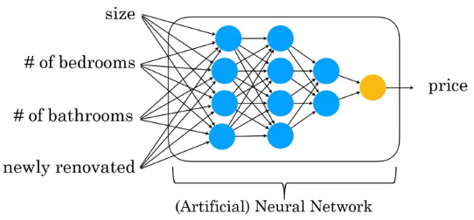
Deep Learning

Slide 56
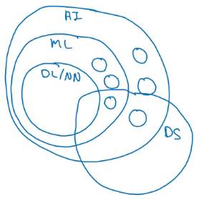
AI and related disciplines
Machine Learning
Data Science
Deep Learning / Neural Network
Supervised Learning
Un supervised learning
Reinforcement Learning

Slide 57
What makes a company AI company?
Strategic data acquisition
Unified datawarehouse
Pervasive automation
New roles such as MLE

Slide 58
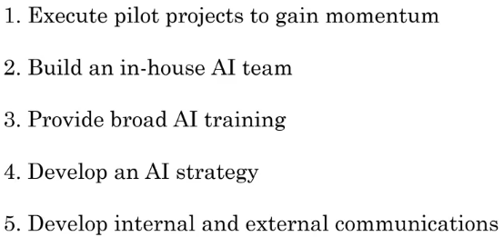
AI Transformation

Slide 59
Deciding about a new project
Technical diligence
Is it feasible project?
Can AI do that?
Pretty much any thing you can do with a second of thought can be automated using supervised learning

Slide 60
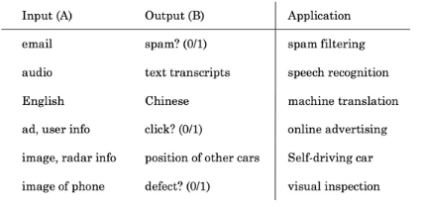
Supervised learning tasks

Slide 61
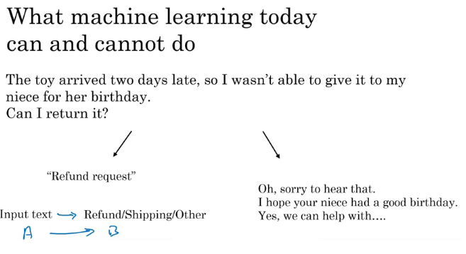

Slide 62
Examples of what ML can and can’t do?
Identifying the intent of the customer - Possible
Writing an emphatic response to customer’s email – Not possible or difficult

Slide 63
Technical diligence rules
You are learning a simple concept
Do you have large training data

Slide 64
More examples
Self driving car
Input is from sensors, camera
Output where are the other cars
Recognizing gesture of traffic police, construction work, people– not possible
Critical application requires good accuracy

Slide 65
X-ray diagnosis
Diagnosing a disease from X-ray images– possible
Diagnosing a disease after reading a book

Slide 66
Strengths and weakness of ML
Works when,
Learning a simple concept
Lots of data available
Doesn’t work when,
Learning a complex concept
Asked to work on new type of data such as X-ray images in different conditions and angles

Slide 67
Demand prediction based on price
Price -> Demand can be modeled using a neural network using a neuron
(Perceptron model)
Network of neurons (ANN)
Price
Shipping Cost
Marketing
Meterial

Slide 68
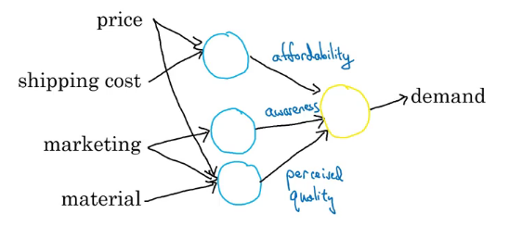

Slide 69
Face recognition
Pictures comprise pixels
Color images and channels
A neural network corresponds to pixels
Earlier layers will detect edges, then lobes and then objects

Slide 70
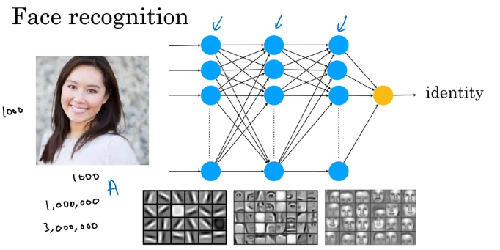

Slide 71
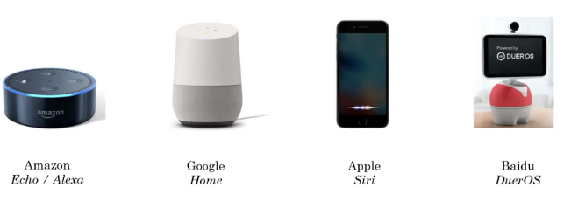
Speech Recognition

Slide 72
Key steps of Echo / Alexa
Collect data
Labelled voice
Train model
Iterate many times
Deploy the model
Get more data and update model

Slide 73
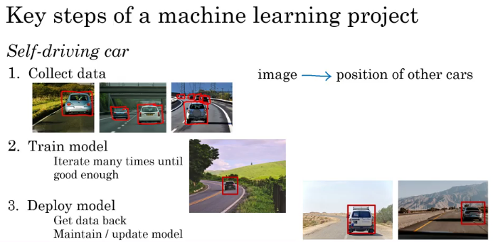

Slide 74
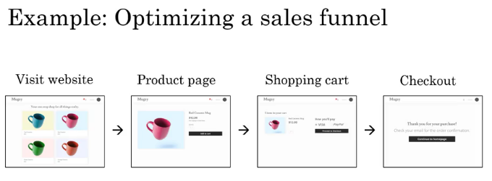

Slide 75
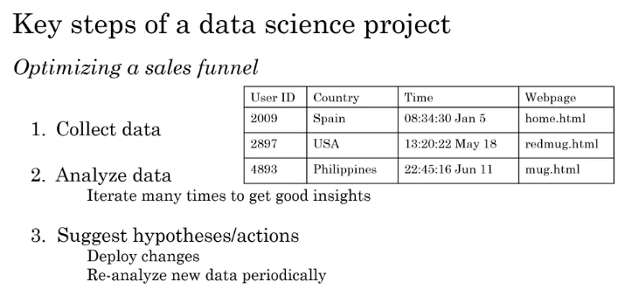

Slide 76
Machine Learning changing job functions
Sales
Identifying sales opportunities
Prioritizing
Manufacturing line manager
Optimize manufacturing
Machine learning can spot defects
Recruiting
Identify how people prefer recruitment
Spot good candidates

Slide 77
Marketing
Optimize website
A/B testing
Recommendation system
Agriculture
What to plant?
Precision agriculture

Slide 78
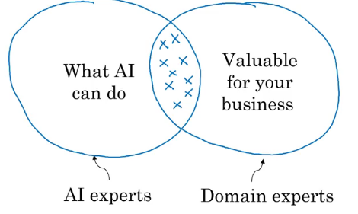
How to chose an AI project?

Slide 79
Brainstorming framework
Automate task rather than job
Automating call center: picking phone, emails, issue refund, call routing
Automating radiologist: X-ray, mentoring other doctors, consulting,
Main drivers of business value
What are the main pain points in your business?

Slide 80
Is it always necessary to have big data?
Having more data is good
With small datasets you can make progress
10, 100 or 1000 data points can be a good start

Slide 81
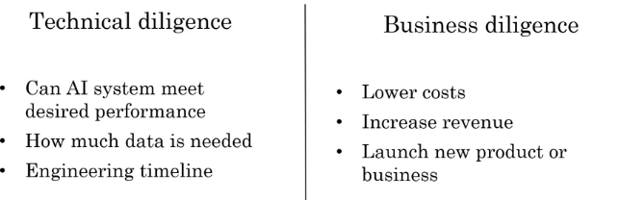

Slide 82
Ethical diligence
Is this going to make society better?

Slide 83
Build Vs Buy
ML projects can be inhoused or outsourced
DS projects are generally inhoused
Buy industry standard, only build specialized products

Slide 84
How to work with AI team
Specify your acceptance criteria
95% accuracy
Training, validation and Test dataset
Don’t expect 100% accuracy
Limitations of ML
Insufficient data
Mislabeled data
Ambiguous labels (human perception)

Slide 85
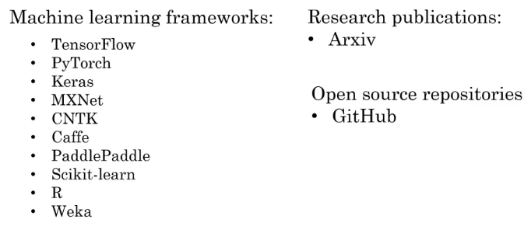
Machine Learning frameworks

Slide 86
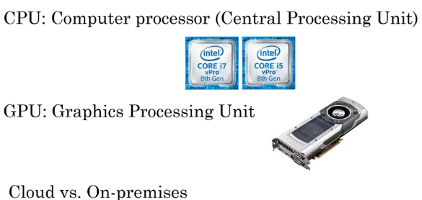
CPU Vs GPU
Edge Deployment

